Slide 1


Sociocultural Learning Theories
John King
AIL 601
October 12, 2023

Slide 2
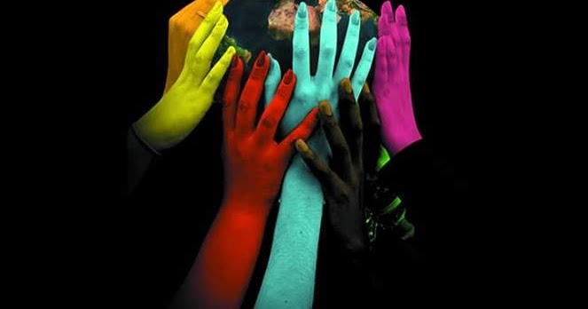
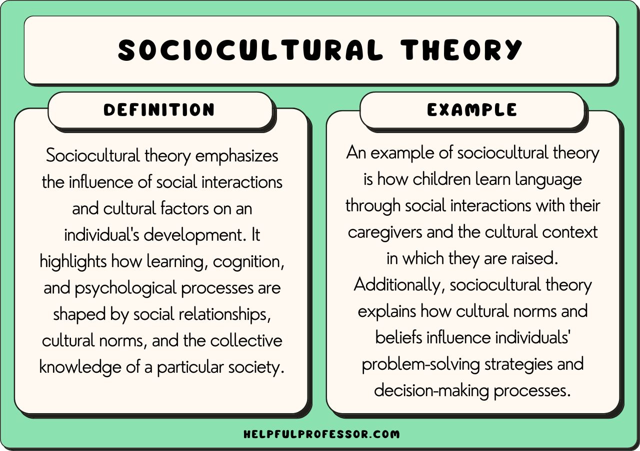
Introduction
Sociocultural Learning theories emphasize the influence of social and cultural contexts on learning and development.
This Photo by Unknown Author is licensed under CC BY-NC-ND

Slide 3
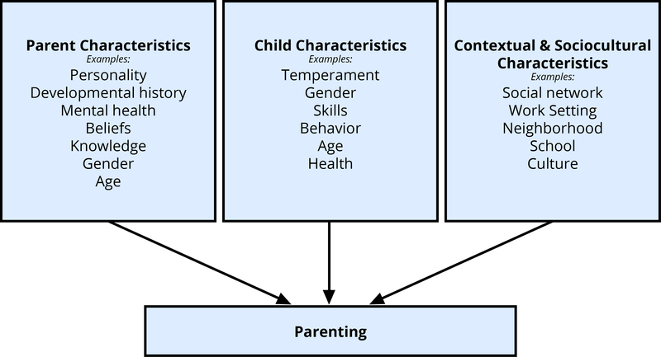
Purpose
To demonstrate how society’s friends, parents, and others develop people’s cognitive, learning, and sociocultural functions.
Educators
Students
Educational Organizations
Policy Makers
Parents
This Photo by Unknown Author is licensed under CC BY
Key Audience
Notes:
Paul Main (March 6, 2023) Sociocultural Theory https://www.structural-learning.com/post/sociocultural-theory#:~:text=Sociocultural%20theory%20is%20based%20on,on%20interacting%20with%20other%20individuals.

Slide 4
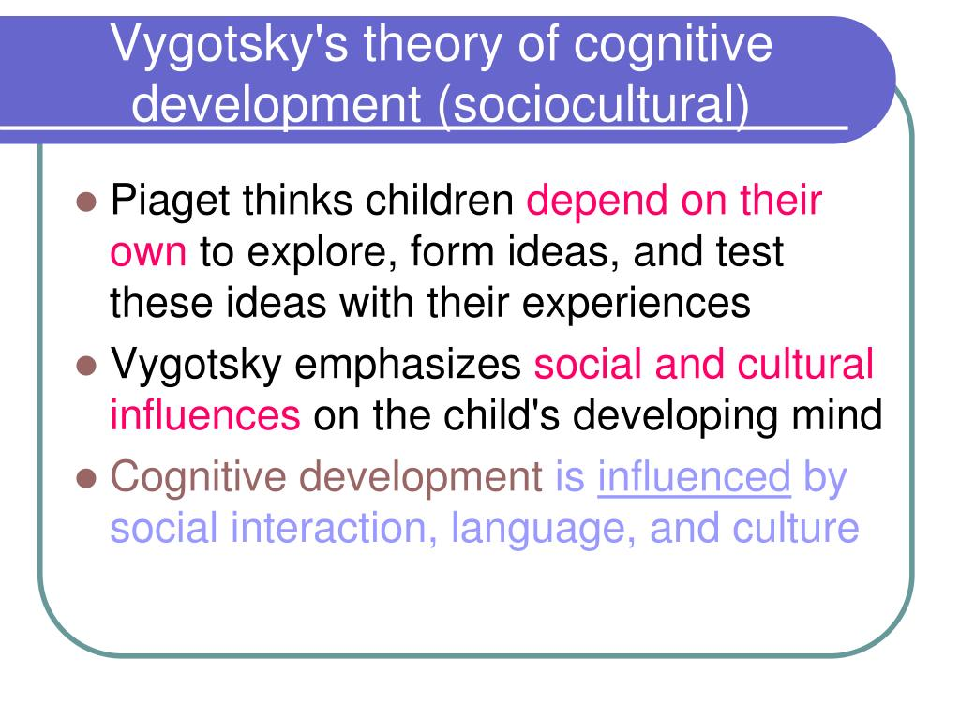
Principles of Sociocultural Theory
Learning is a social process.
Learning is mediated by language and communication.
Zone of Proximal Development (ZPD) is the space between what a learner can do alone and what they can do with help.
Scaffolding: Providing guidance and support within the ZPD.
Apprenticeship: Learning from more skilled individuals.
Learning is context-dependent.
Learning is culturally situated.

Slide 5
Key Elements
Cultural Tools: Language, symbols, and artifacts.
Internalization: Process of turning external activities into mental processes.
Mediation: Use of tools, language, and symbols to support learning.
Collaborative Learning: Working together to achieve common goals.
Community of Practice: A group that shares knowledge and practices.

Slide 6
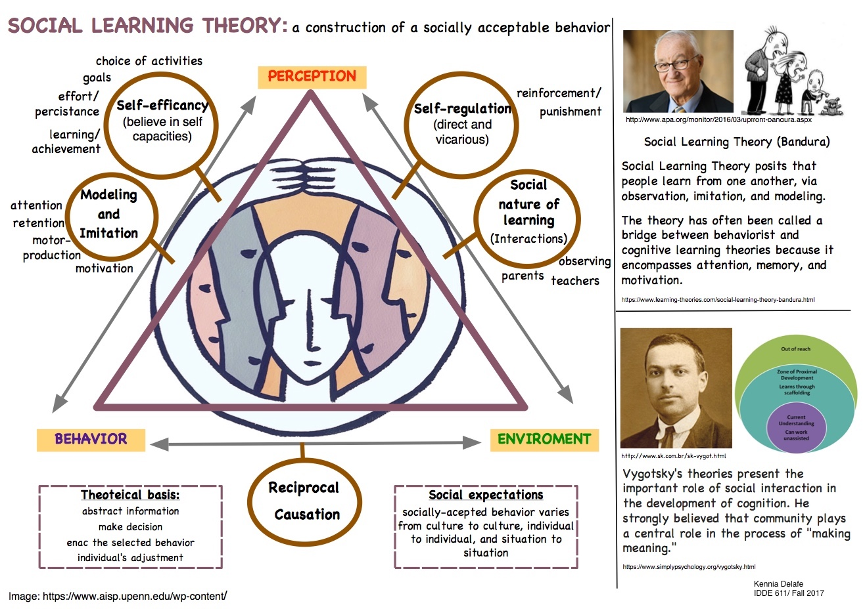
Implications
Educational settings should encourage social interaction and collaboration.
Importance of dialogue, discussion, and peer teaching.
Teachers act as guides and facilitators.
Recognize and respect cultural diversity.
Contextualize learning experiences.

Slide 7
Sociocultural Theory Examples
Kids these days: In the 1980s, children played on the streets until dark. Today, children are rarely allowed to leave adult supervision. There is an argument that ‘kids back then’ were more independent, less coddled, and more self-confident at a much younger age.
Digital natives: There is a perception that children who grow up in tech-connected homes have a natural ability to use technology, while ‘digital immigrants’ who learn technology at a later age never seem to be able to catch up (this theory is primarily debunked).
Kids with scissors: A child in America doesn’t learn to handle scissors until age seven because it’s considered too dangerous. By age 7, a child in the developing world already has excellent dexterity in using blades to cut up meat for dinner.
Single child social development: A single child has a remarkable ability to communicate with adults because she spent her whole life playing with adults. Down the street, a child with five siblings seems incapable of interacting with adults but is much better at making friends in childhood.
Classroom activities that promote sociocultural learning.
Online communities for learning and knowledge sharing.
Workplace apprenticeships.
Cultural and historical analysis of learning.

Slide 8
References
Paul Main (March 6, 2023) Sociocultural Theory from https://www.structural-learning.com/post/sociocultural-theory#:~:text=Sociocultural%20theory%20is%20based%20on,on%20interacting%20with%20other%20individuals.
Cherry, K. (February 2022) What is Sociocultural Theory? VeryWell Mind. Retrieved from https://www.verywellmind.com/what-is-sociocultural-theory-2795088
McLeod, S. (2020) Vygotsky’s Sociocultural Theory of Cognitive Development. Simply Psychology. Retrieved from https://www.simplypsychology.org/vygotsky.htm
(May 2022) Sociocultural Theory of Cognitive Development A Guide to Vygotsky’s Theory of Learning from https://www.mcw.edu/-/media/MCW/Education/Academic-Affairs/OEI/Faculty-Quick-Guides/Sociocultural-Theory-of-Cognitive-Development.pdf
Dave Cornell (September 8, 2023) 18 Sociocultural Theory Examples from https://helpfulprofessor.com/sociocultural-theory-examples/
Brighthub Education (2022) Activities for Sociocultural Theory: A Second Language Acquisition Theory Module from https://www.brighthubeducation.com/teaching-tips-foreign-languages/97396-using-the-sociocultural-theory-module-in-your-classroom/#:~:text=Aside%20from%20the%20classic%20role%20playing%2C%20here%20are,or%20choose%20options.%20...%203%203.%20Language%20Date

