Slide 1


Conditions of Educational Change
John T. King Jr.
AIL 601
Ph.D. Student

Slide 2
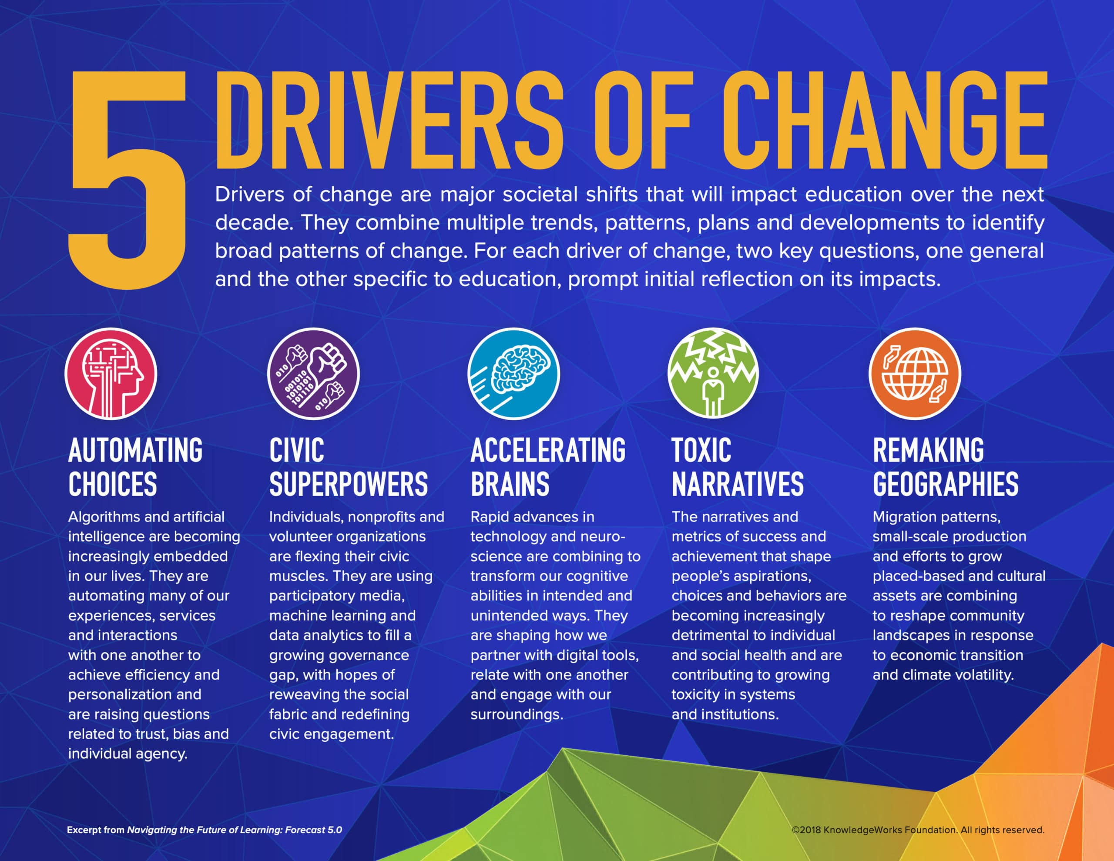
Title: Technology Adoption Models in Instructional Technology
Audience: Teachers, professors, or administrators who seek
guidance from the educational change literature.
Purpose: To ensure that educational reforms align with evolving needs and aspirations and to maintain an effective education system capable of preparing individuals for the challenges of tomorrow’s world.
Reference
Jason Swanson ( December 3, 2018) Trends, Patterns and Signals: Five Drivers of Change on the Horizon for Education

Slide 3
Educational change is a constant, evolving process influenced by a multitude of factors, from societal shifts to technological advancements. The conditions governing these changes are intricate and often multifaceted, shaped by diverse elements that impact the education system globally. Understanding the conditions of educational change involves delving into various aspects that contribute to its complexity.
(Shah, 2015) “Sustainable development is development that meets the needs of the present without compromising the ability of future generations to meet their own needs”
Reference
Iqra Shah (May 18, 2015) Educational Change and Development from https://www.slideshare.net/IqraShah3/education-ppttemplate022-48295288

Slide 4
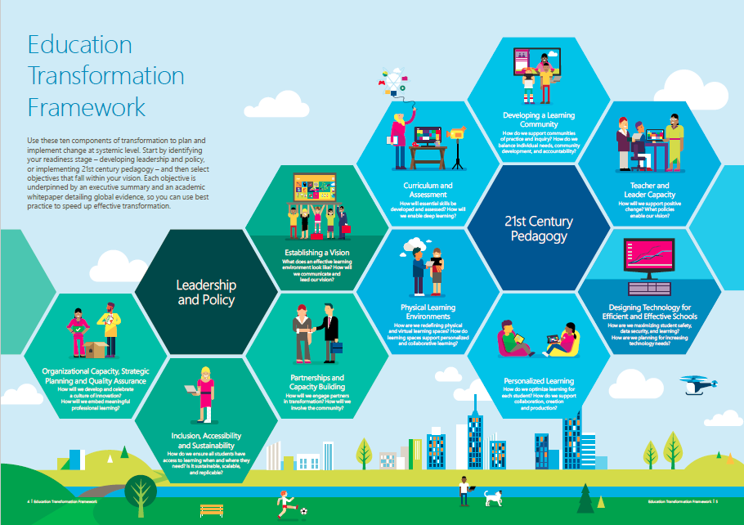
Reference
mindsharelearning (January 31,2017) Microsoft Education Transformation Corner: Personalized Learning from https://mindsharelearning.ca/microsoft-education-transformation-corner-personalized-learning/

Slide 5
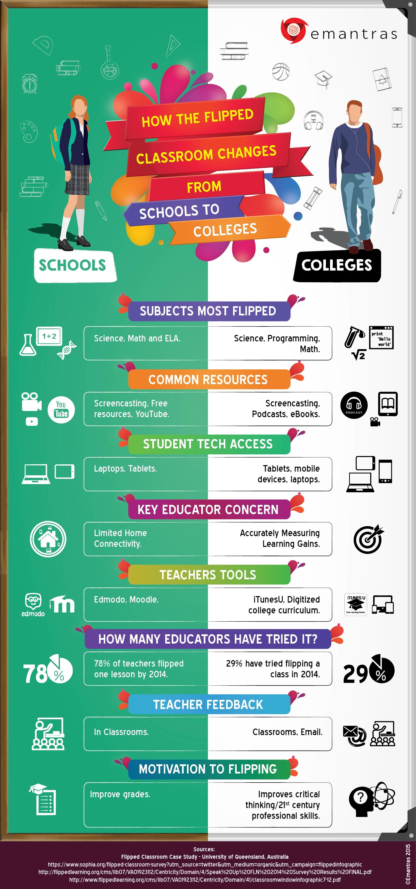
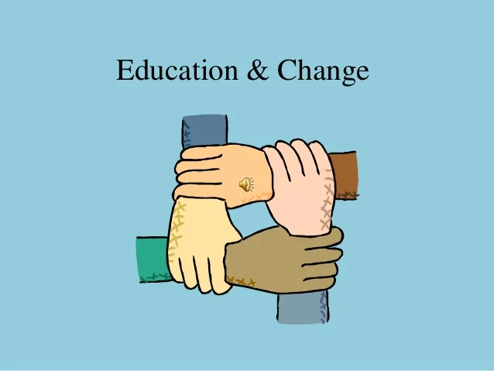

Slide 6
Conclusion
The educational system is challenging on many levels, and keeping up with change only adds to that. For change to work, thoughtful planning and strategic methods must be put in place to meet the challenge.
1. Stakeholder Engagement: educators, students, parents, administrators, policymakers, and community members must feel a sense of ownership to ensure diverse perspectives are considered to increase the likelihood of successful implementation.
2. Professional Development: Offering comprehensive and ongoing professional development for educators is essential. Training programs that introduce new methodologies, technologies, and teaching strategies equip teachers to adapt to change effectively and implement innovative practices in the classroom.
3. Pilot Programs and Experimentation: Testing changes on a smaller scale through pilot programs allows for experimentation, refinement, and identification of potential challenges before broader implementation. This approach mitigates risks and provides valuable insights for scaling initiatives.
4. Flexible Implementation Strategies: Flexibility in implementation strategies is crucial. Education systems are complex, and adaptability is necessary to address unforeseen challenges, adjust to evolving needs, and incorporate feedback during the change process.
5. Data-Driven Approach: Utilizing data and evidence-based practices helps in making informed decisions. Monitoring and evaluating the impact of changes using relevant metrics and data collection methods provide insights into the effectiveness and areas needing improvement.
Embracing a culture of continuous improvement allows for adjustments, refinements, and ongoing adaptations to ensure that changes remain relevant and effective.

